Slide 1
Garbage Collector
When the new operator is used to create an object, that object’s memory is taken from the managed heap. When we close the application the object will not be deleted from the heap memory this makes performance issued of the application.
Garbage collector is a service of CLR to release unused objects memory from heap, this provides automatic memory management.[developer involvement is not there in releasing objects memory, this makes automatic memory management]
The object which doesn't have reference from an application is called ‘unused object’
GC is a .NET framework thread, which runs when needed
CLR will call garbage collector in 2 cases
When application requires memory
When application is closed

Slide 2
Garbage Collector
When the new operator is used to create an object, that object’s memory is taken from the managed heap. When we close the application the object will not be deleted from the heap memory this makes performance issued of the application.
Garbage collector is a service of CLR to release unused objects memory from heap, this provides automatic memory management.[developer involvement is not there in releasing objects memory, this makes automatic memory management]
The object which doesn't have reference from an application is called ‘unused object’
GC is a .NET framework thread, which runs when needed
CLR will call garbage collector in 2 cases
When application requires memory
When application is closed

Slide 3
Garbage Collector
Calling Garbage collector when application requires memory can be considered as an advantage, this will not effect performance of application.[calling garbage collector more number of times into app takes more processor time, this will effects app performance.]
Developer can call Garbage collector explicitly
System.gc.collect()-it will call garbage collector
The major advantage of garbage collector comes for server based application development.

Slide 4
Garbage Collector
Allocation
The managed heap is essentially a block of contiguous memory. When a new object is created, that object’s memory is allocated at the next available location on the managed heap. If there is available memory the garbage collector does not need to search for space and allocations are very fast. If the memory is insufficient to create the object, the garbage collector attempts to reclaim space for the new object.
Collection
To reclaim memory the garbage collector collects and destroys objects which are no longer available which is when there are either no references to it, all the references are set to null, or else all references to it are from other objects that can be collected. The process of a collection involves moving available objects into the memory and reclaiming the memory used by objects which are no longer used. An object Which survives a collection is automatically promoted to the next generation (see below).

Slide 5
Garbage Collector
Generations
In Managed heap The garbage collector classifies all objects into on of three generations (Gens) uses three generations to group objects by their lifetime and volatility:
Gen 0 – Newly created objects. Gen 0 is collected frequently to ensure that short-lived objects are quickly collection and memory released. Objects that survive a Gen 0 collection are promoted to Gen1.
Gen 1 - Collected less frequently than Gen 0 and contains longer-lived objects which were promoted from Gen 0. Objects that survive a Gen 1 collection are promoted to Gen 2.
Gen 2 – Objects promoted from Gen 1 (i.e. the longest-lived objects) and collected infrequently. The overall strategy of the garbage collector is to collect and move longer-lived objects less frequently.

Slide 6
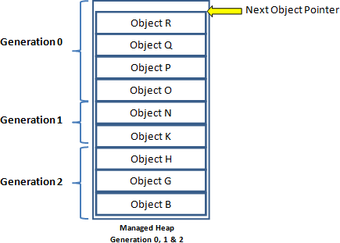
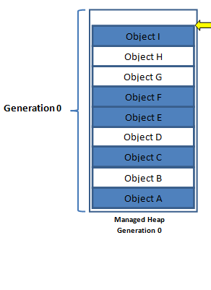
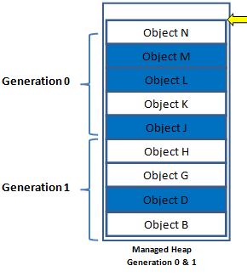

Garbage Collector

Slide 7
Garbage Collector
Finalize():
The Finalize destructor is a special method .
The .NET Framework automatically runs the Finalize() destructor to destroy objects in the memory.
It is called by CLR using garbage collector, the CLR periodically check for objects that are not used by the application. When such an object is found, the Finalize() destructor is called automatically and the garbage collector of the CLR release the object from the memory.

Slide 8
Garbage Collector
Dispose():
The Dispose() method is called to release a resource, such as database connection, as soon as the object using such a resource is no longer in use.
Unlike the Finalize() destructor, the Dispose() method is not called automatically.
You must explicitly call it from a client application when an object is no longer needed.
The IDisposable interface contains the Dispose() method. Therefore , to call the Dispose() method, the class must implement the IDisposable interface.
class MyClass:IDisposable
{
public void Dispose()
{
//implementation
} }

